Slide 1


BOX OFFICE MOVIE ANALYSIS
A GROUP 6 PROJECT

Slide 2


“WE DON’T MAKE MOVIES TO MAKE MONEY, WE MAKE MONEY TO MAKE MORE MOVIES”
~ WALT DISNEY ~

Slide 3





Objective: Explore which film genres, release times, and formats are the most successful at the Box Office.
Deliverable: Help our new client’s studio make smarter, more profitable films.
Data sources: Box Office Mojo, IMDb, Rotten Tomatoes, The Numbers.
OVERVIEW

Slide 4

BUSINESS UNDERSTANDING

Slide 5
BUSINESS UNDERSTANDING
Challenge: We are entering a competitive market without movie production experience.
Key Business Questions:
Which genres are most profitable?
What release season(Q1-Q4) maximizes earnings?
What is the impact of talent (actors, actresses, and directors) on revenue generated?

Slide 6
DATASET UNDERSTANDING AND PROCESSING

Slide 7
DATASET UNDERSTANDING
Datasets used:
Bom.movie_gross.csv:
Source: Box Office Mojo
Key Fields: title, studio, domestic_gross, year
Purpose: Revenue insights & release timing
Movie_budgets.csv:
Source: The Numbers
Key Fields: movie, release_date, production_budget, worldwide_gross
Purpose: Budget, total profits, ROI calculation

Slide 8
DATASET UNDERSTANDING CTD...
IMDb SQLite Database:
Tables used:
Movie basics:
Fields: primary_title, runtime_minutes, genres, mpaa_rating
Purpose: Genre classification, runtime, content rating
Movie ratings:
Fields: movie_id, average_rating, num_votes
Purpose: IMDb audience rating insights
Join key: movie_id between movie_basics and movie_ratings
Merged with other datasets using primary_title and release_year

Slide 9
DATASET PROCESSING
Standardised title casing and removed punctuation for better joins.
Resolved genre inconsistencies (e.g., splitting multi-genre values).
Filtered out unreleased/limited release and incomplete records.
Final dataset includes:
Year, runtime minutes, genres, average rating, release date, production budget, domestic gross, worldwide gross.

Slide 10

DATA ANALYSIS

Slide 11
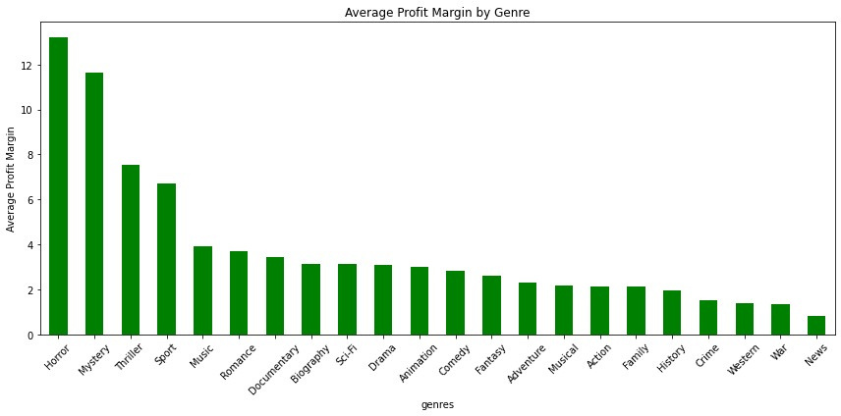
GENRE PROFITABILITY
Horror, Animation, and Thriller genres deliver the highest return on investment, thanks to low production costs and broad or loyal audience appeal.

Slide 12
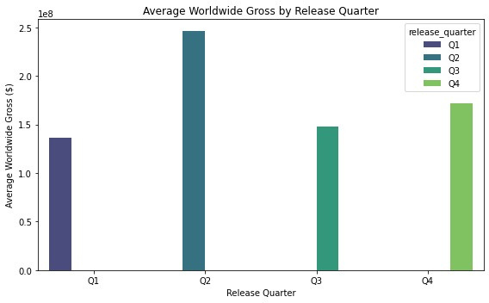
SEASONAL TRENDS
Insight: Movies released in Q2 and Q4 generate the highest revenue, making them the best seasons for maximizing box office success.

Slide 13
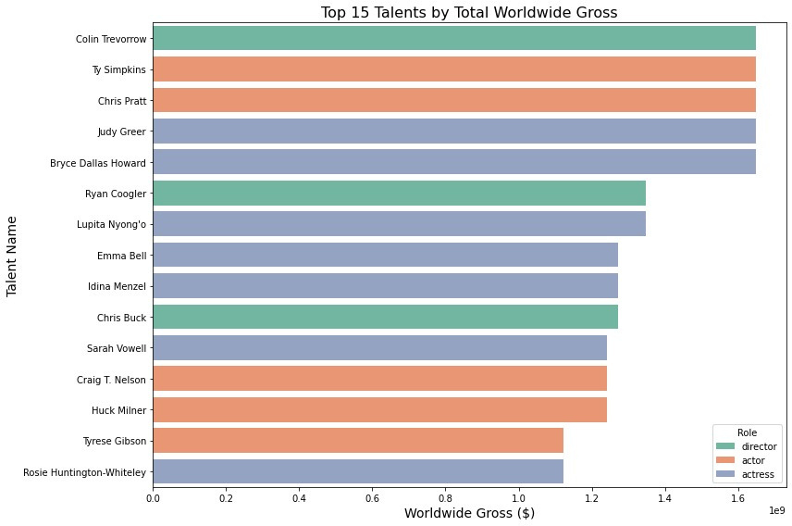
TALENT IMPACT ON REVENUE
Colin Trevorrow, Ty Simpkins and Judy Greer are the highest grossing director, actor and actress respectively.

Slide 14
RECOMMENDATIONS

Slide 15
RECOMMENDATIONS
Make movies in the Horror, Mystery, and Thriller genres because they generate more ticket sales and have higher average profit margins.
Release movies in the second quarter of the year (April to June) since the studio is likely to earn ore worldwide gross.
Invest in directors, actors and actresses that have starpower and visibility to draw in big audiences.

Slide 16
NEXT STEPS
Analyse the effect of genre combinations or subgenres (e.g. Adventure and action, or Horror and comedy) on revenue
Build a predictive model to forecast box office performance using historical data on genres and release dates
Include post-theatrical success and streaming revenue to improve insights on movie success
Incorporate data on age demographics to make movies that target specific audiences

Slide 17

DIRECTED BY:
Charity Mwangangi
Keith Tongi
Edgar Muturi
Jacob Abuon
Edna Maina
Kevin Karanja

Slide 18

THANK YOU, QUESTIONS?
Emails
keith.tongi@student.moringaschool.com
kevin.karanja@student.moringaschool.com
jacob.abuon@student.moringaschool.com
edna.maina@student.moringaschool.com
edgar.muturi@student.moringaschool.com
charity.mwangangi@student.moringaschool.com

